Slide 1

SwacchhAI: Live Waste segregation
By:
Amisha Patel
Hemil Shah

Slide 2
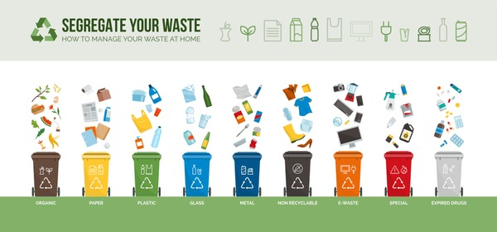
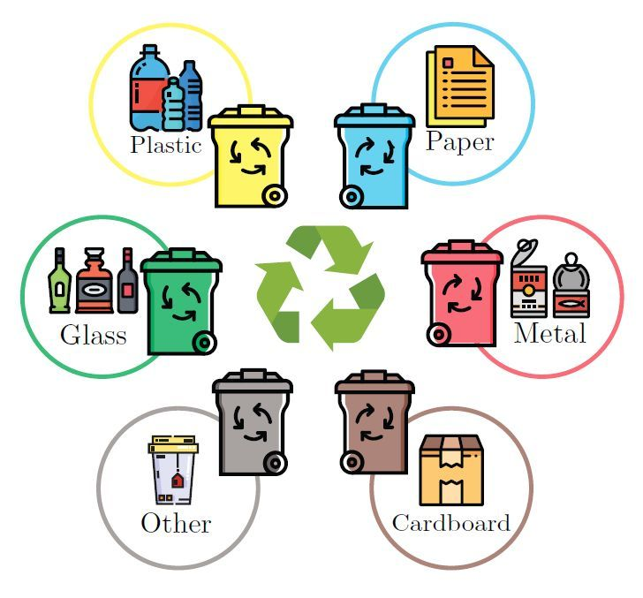
The Problem
The people who are living in backward or rural areas, they tend to have very less knowledge about the Segregation of Waste. They dump all their wastes at a single place, and thereby suffer from various diseases, and other problems.
For this Problem, we have created SwacchhAI, a Waste Segregation System, which can classify from real-time data. This project would help them segregate their wastes properly, without any support of any person.
Also, Real-time data would be a positive side of this project, as it does not require the user to take a picture and upload it to the app. The waste can be displayed in front of the camera, and they are good to go.
2x – 3x
The user can save their time drastically, by this project. They save their time of clicking photos and uploading them. They just need to display the waste in front of the camera.

Slide 3
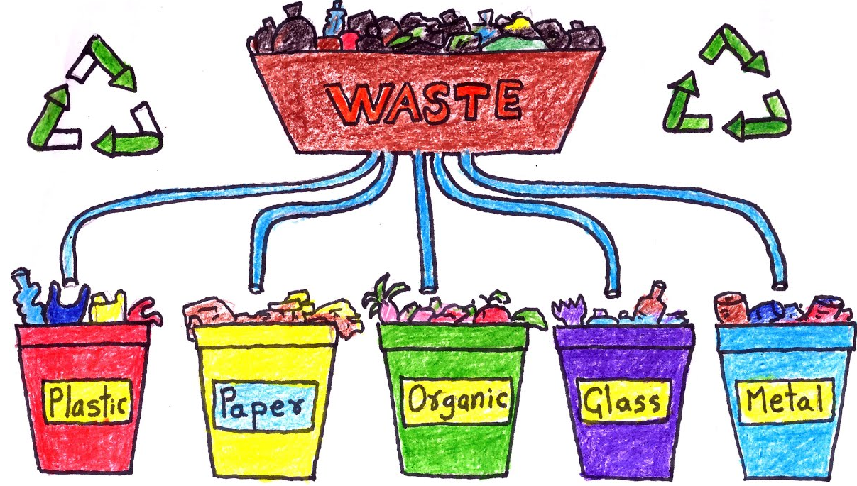
Idea Brief
OBJECTIVE:
Building SwacchhAI, a Waste Classification Tool, that provides real-time, accurate, and time saving output, classifying the wastes in real-time through the camera of the user.
The following features will be included:
Real-Time Waste Classification
More waste classes can be identified
Real-Time Coordinates of the part of the feed, detected as waste
Multi-Lingual support
Explanation about the type of waste classified.
The Admin- Side Application:
Can keep a record of the users using the tool
Can have a look at the data being fed by the users.
Can contact the user, if there is anything suspicious/ dangerous/ hazardous waste is found, and needs treatment immedietly.

Slide 4
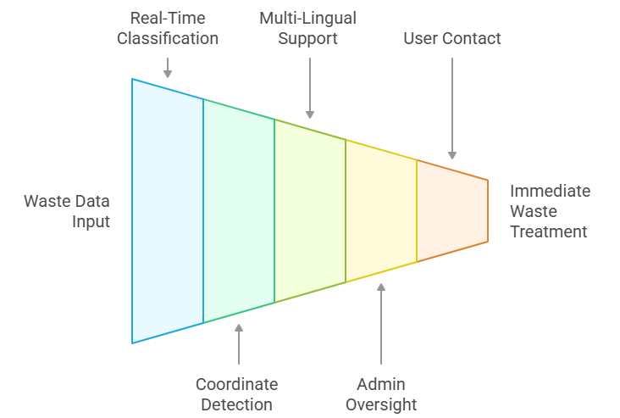
Process Funnel:

Slide 5
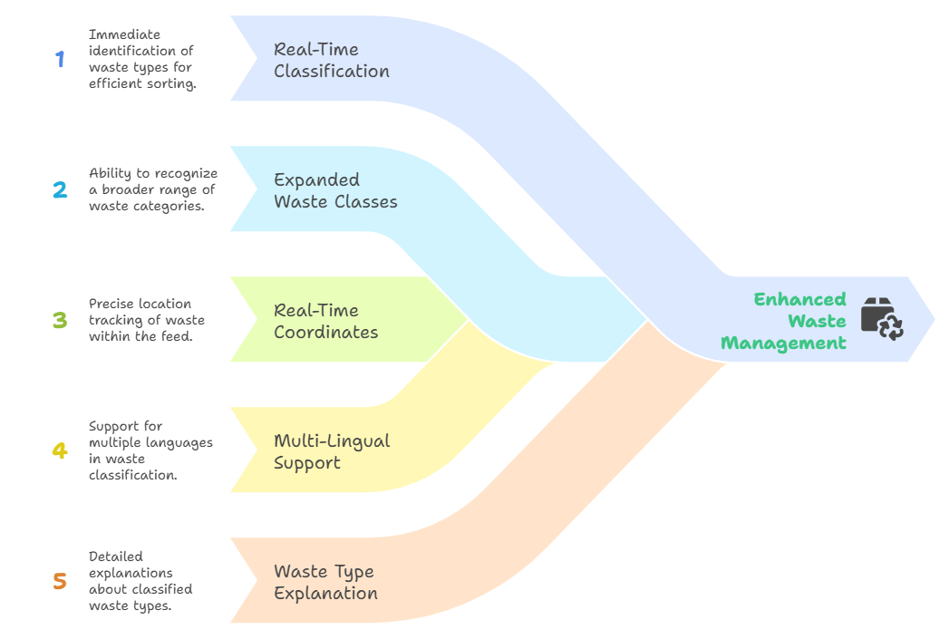
Solution Features

Slide 6
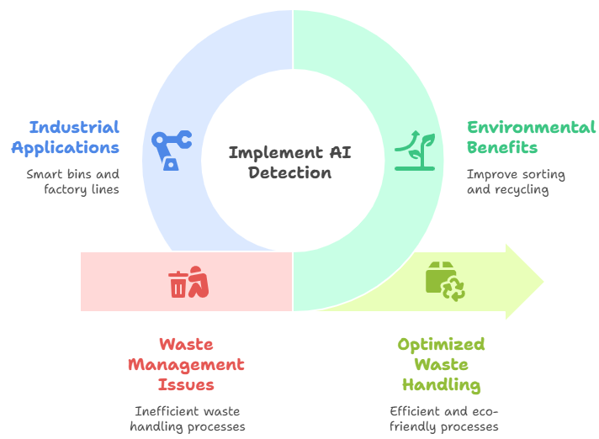
Impact of the Solution

Slide 7
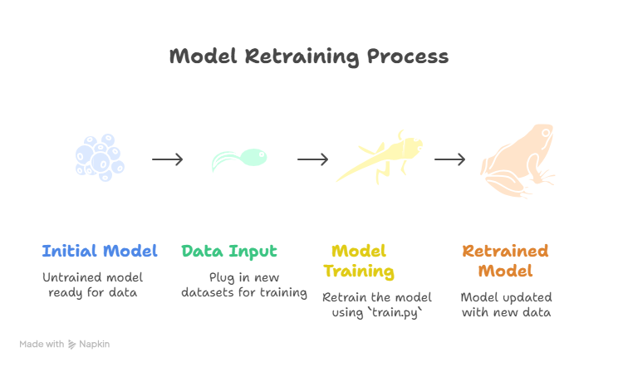
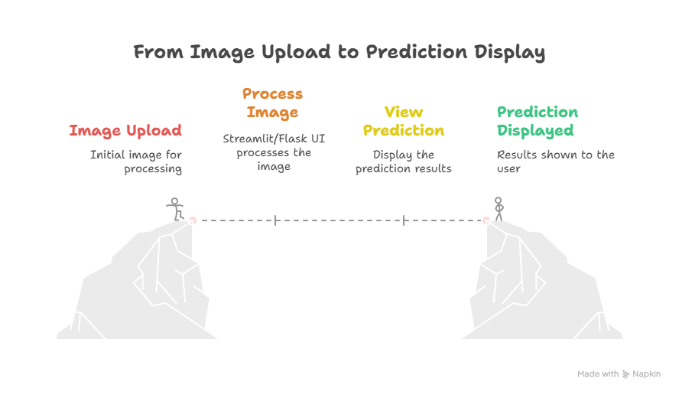
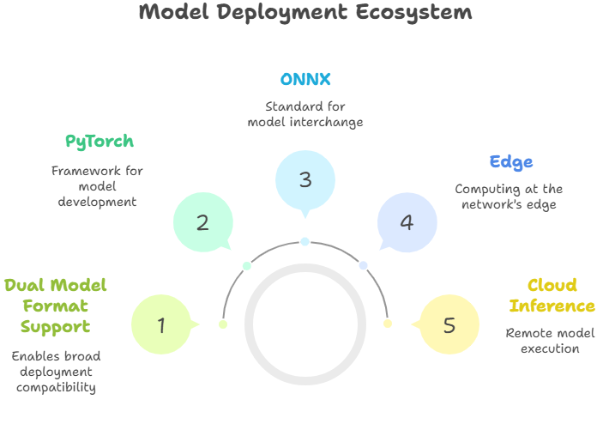
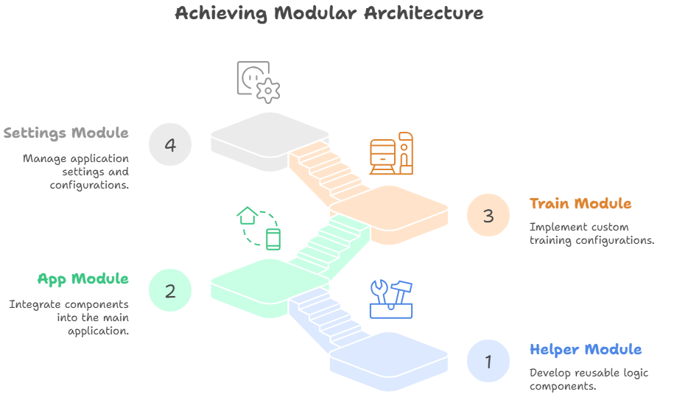
Stand- out areas

Slide 8
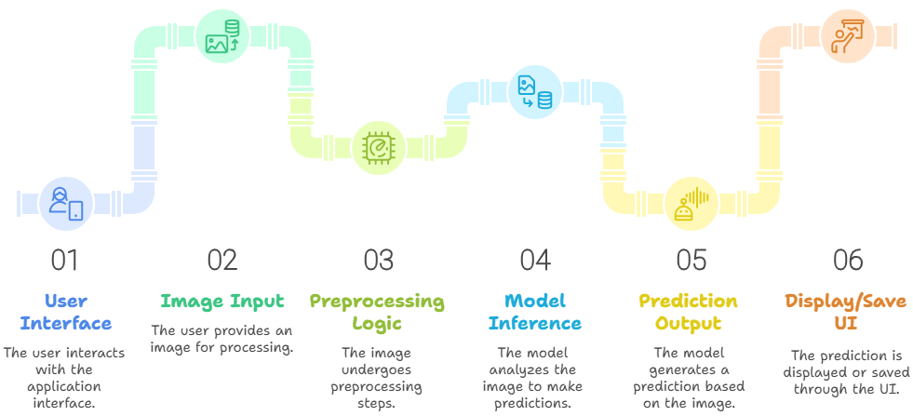
Architecture Diagram

Slide 9
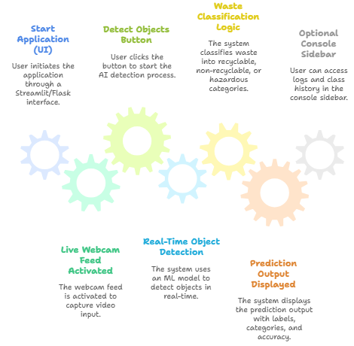
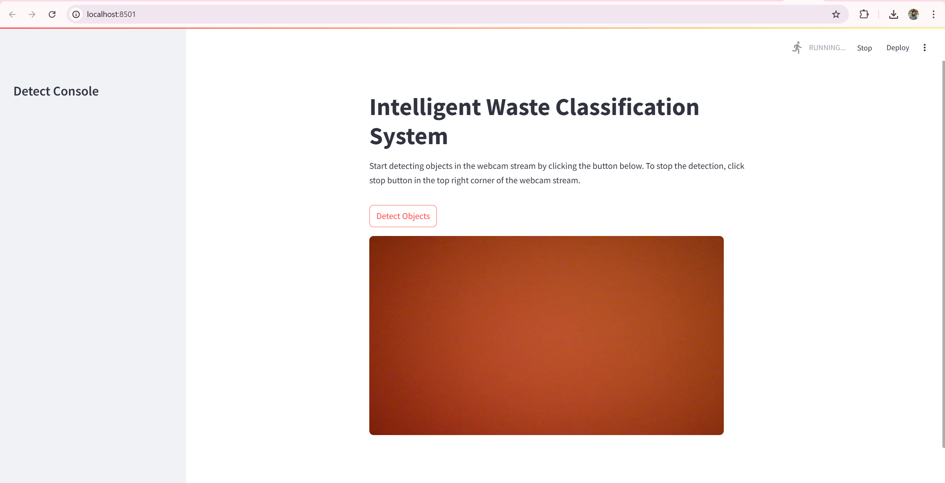
User-Side interface
"Smart detection for a cleaner tomorrow."

Slide 10
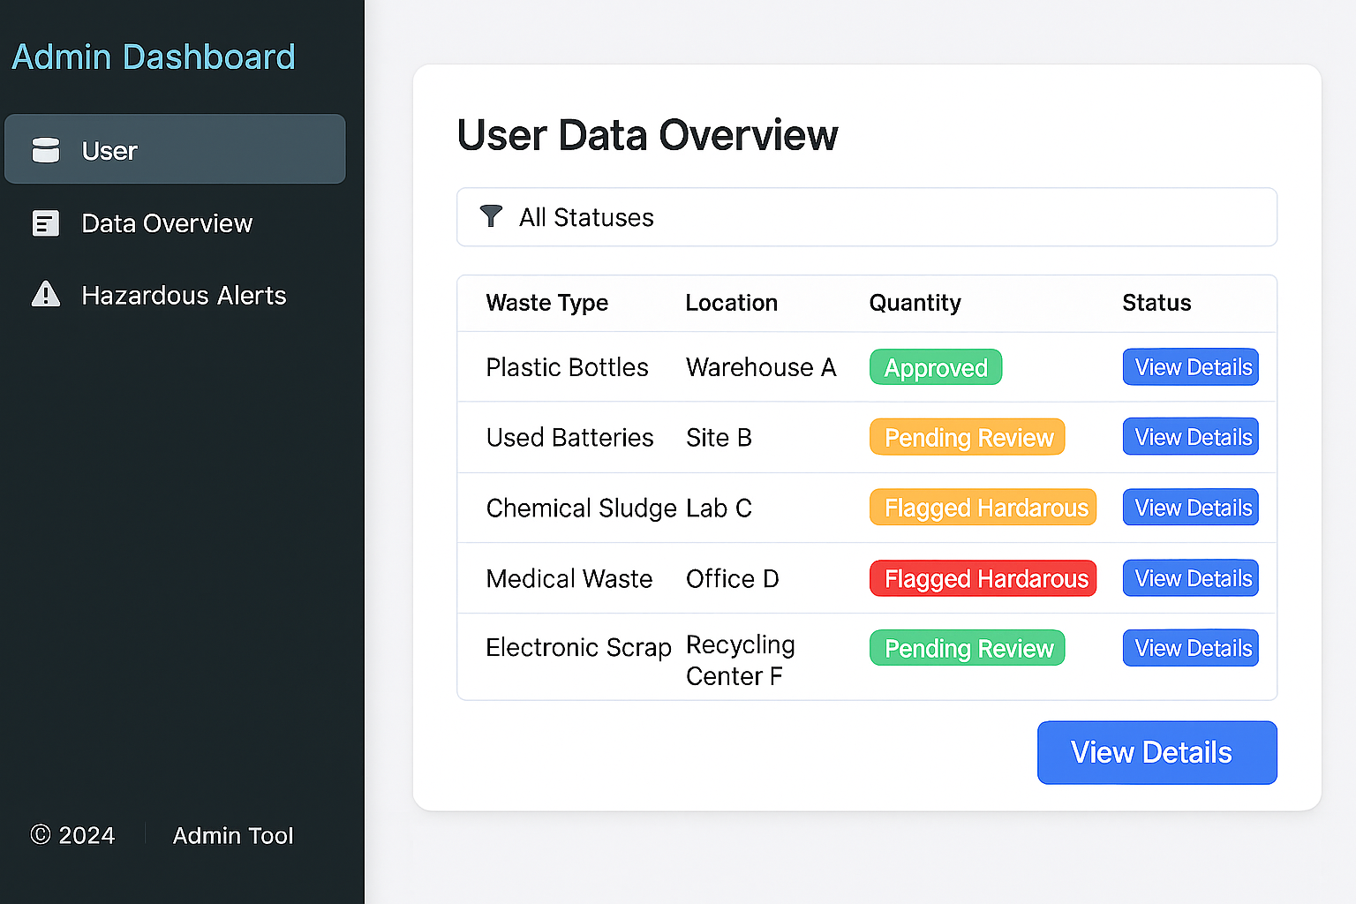
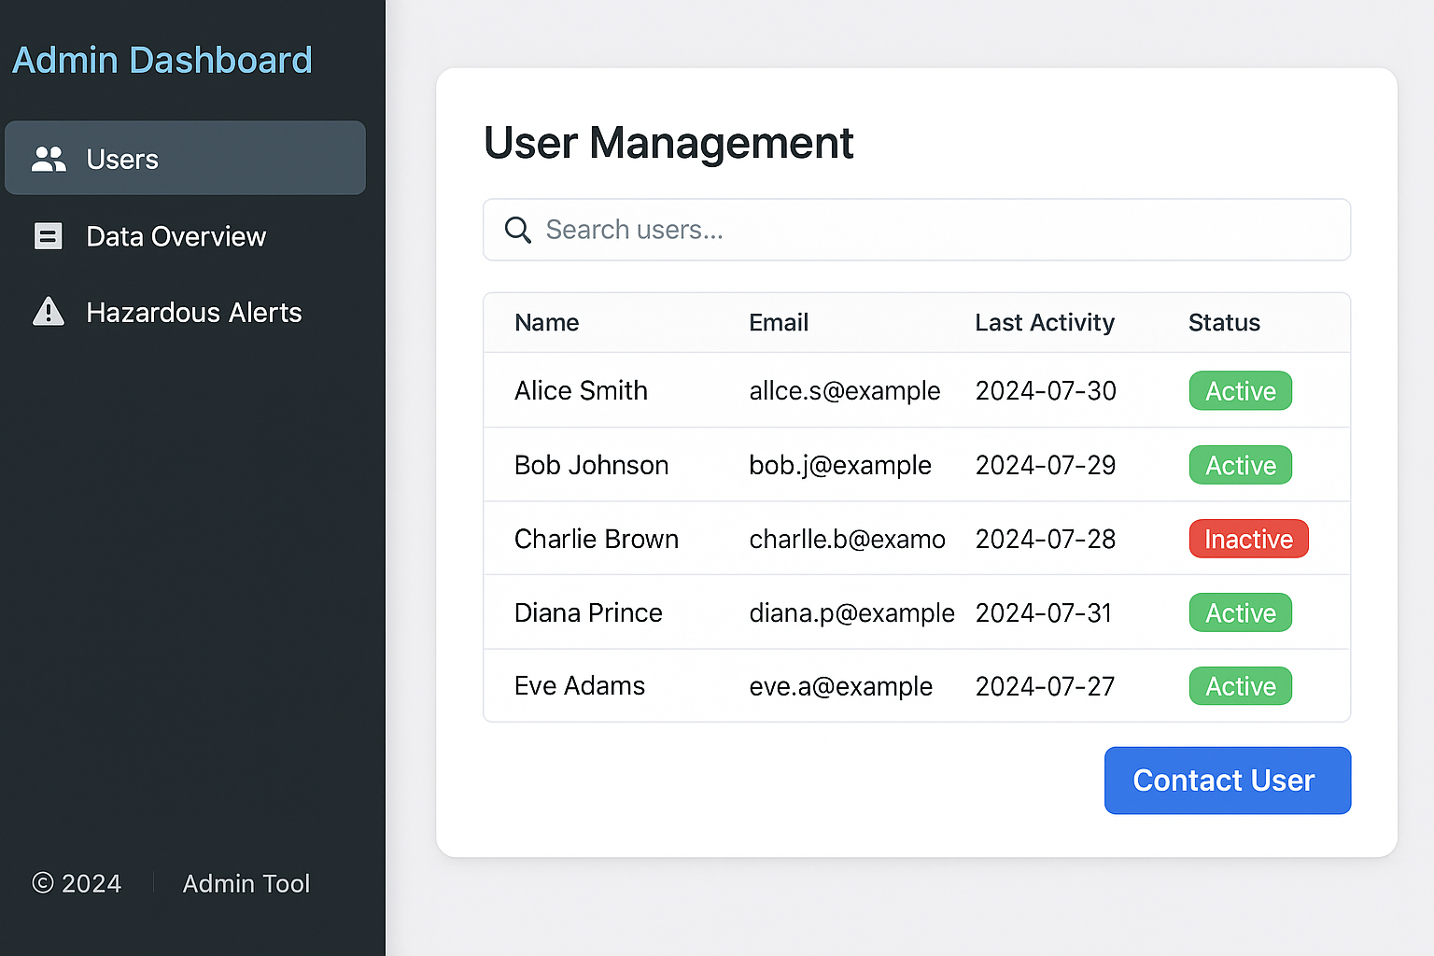
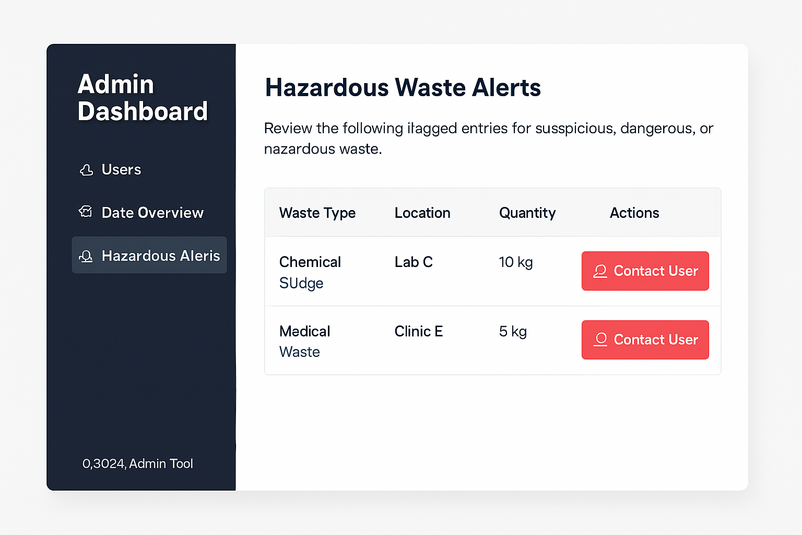
ADMIN-SIDE interface
"Smart detection for a cleaner tomorrow."

Slide 11
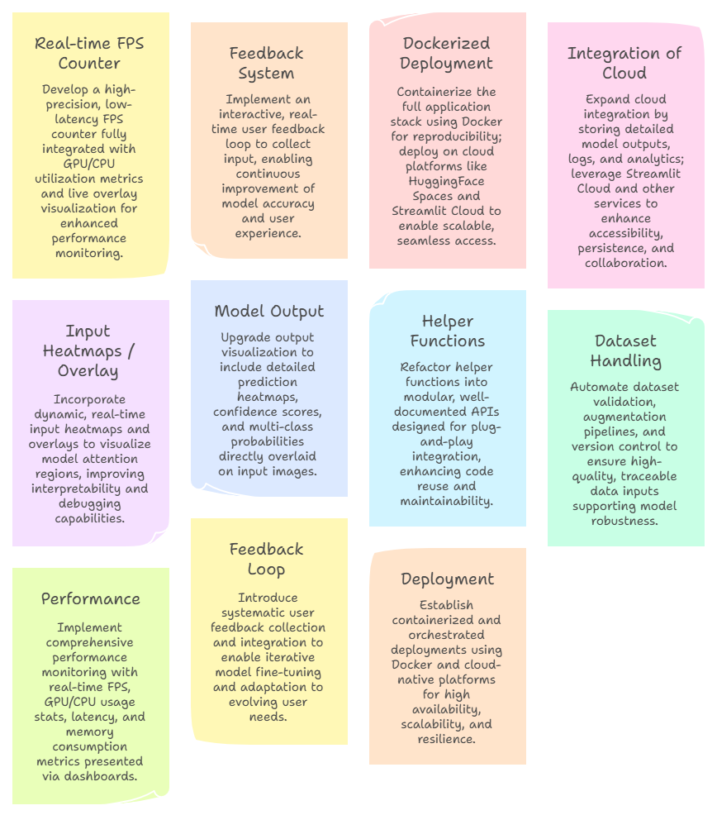
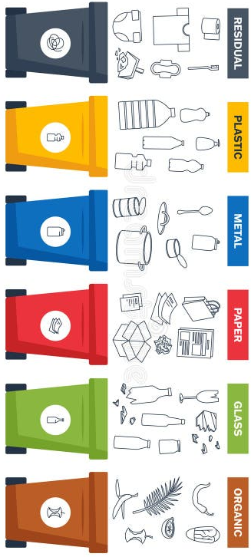
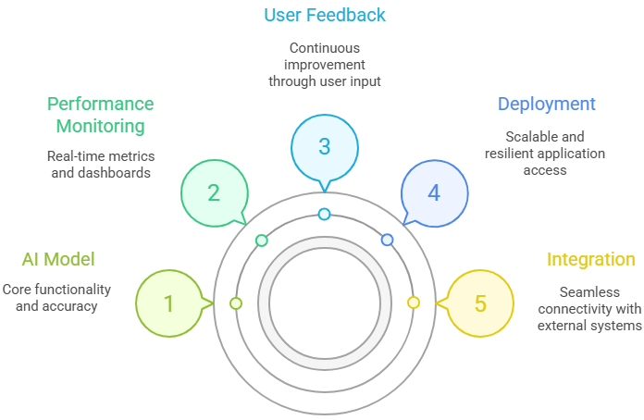
Future Scope

Slide 12


